Slide 1
Selecting best area for a Jamaican restaurant in Mexico City

Slide 2
Introduction
Mexico City is a cultural center, where food is of big importance and a great place for investment.

Slide 3
Data acquisition
Data related to criminality reports until february 2021 was obtained from:
https://datos.cdmx.gob.mx
Data related to earthquakes, fracture and flood risk was obtained from:
https:// datos.cdmx.gob.mx
Data of neighborhoods in Mexico City was obtained from:
https://sig.cdmx.gob.mx/
Data from international restaurants was obtained from:
https://foursquare.com

Slide 4
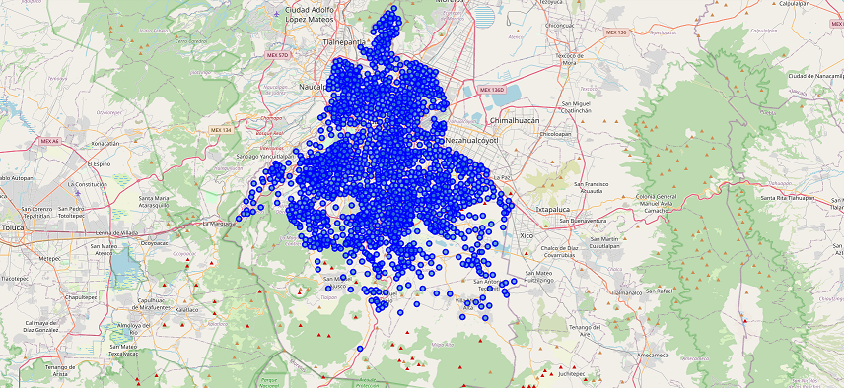
Data analysis
Neighborhoods in Mexico City

Slide 5
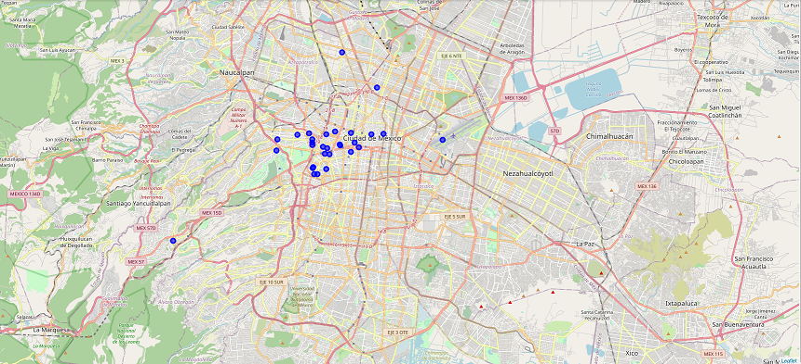
International restaurants in the City.

Slide 6
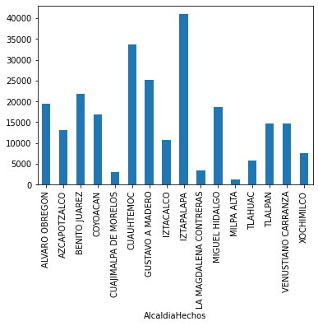
Robbery and threaten crimes in the city until February 2021.

Slide 7
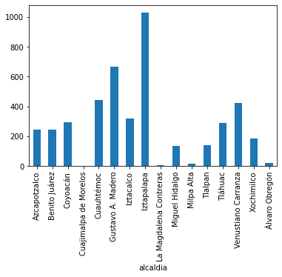
Naturar disaster risk related to earthquakes, flooding and underground loss.

Slide 8
Conclusion
Natural disaster risk for earthquake, flood and underground loss.
  The boroughs with less than 200 are Cuajimalpa, Magdalena Contreras, Miguel Hidalgo, Milpa Alta, Tlalpan and Alvaro Obregón.
Violent crime cases
  The boroughs with less than 15000 are Azcapotzalco, Iztacalco, Tlahuac and Xochimilco, being these last two not considered because of being considered rural areas.
  The boroughs with less than 5000 are Cuajimalpa, Magdalena Contreras and Milpa Alta considered low-income.
High-income boroughs are Coyoacán, Azcapotzalco, Gustavo A. Madero, Cuajimalpa.
The best borough option for a Jamaican restaurant is Cuajimalpa.

Slide 9
Future directions
It would be important to check the cases of specific neighborhoods.
A deeper view in the socio-economical development of the areas.

